Slide 2
MODI
A leap towards SAE L4 automated driving features
UITP Global Summit,
Barcelona
07-06-2023

Slide 3

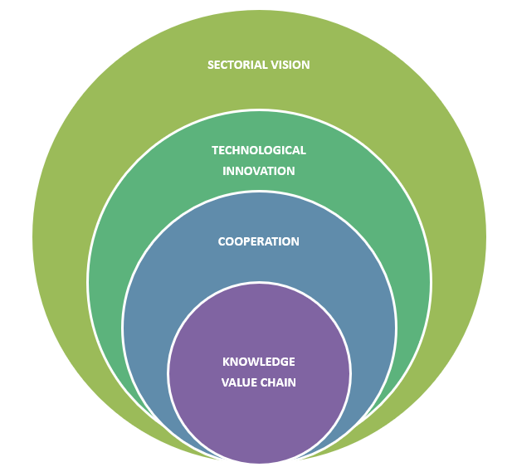
About IN-MOVE by Railgrup
IN-MOVE is a cluster created in 2002 to strengthen the competitiveness of the railway industry
IN-MOVE has become a benchmark cluster in Transportation and Logistics in Spain
Through open innovation, technological excellence, cross-sectoral knowledge and the development of joint projects
Access to a large industrial network of partners at International level
+ 126 members including public and private operators, engineering firms, start-ups, sensor-mobility systems, OEMs, rail infrastructure suppliers and logistics stakeholders
+20 EU framewok programme projects catalyzed for members
Founder member of ERCI (European Railway Cluster Initiative): 15 EU Clusters, collaborating to enhance the competitiveness of companies and systems. + 2000 SMEs in ERCI ecosystem.

Slide 4
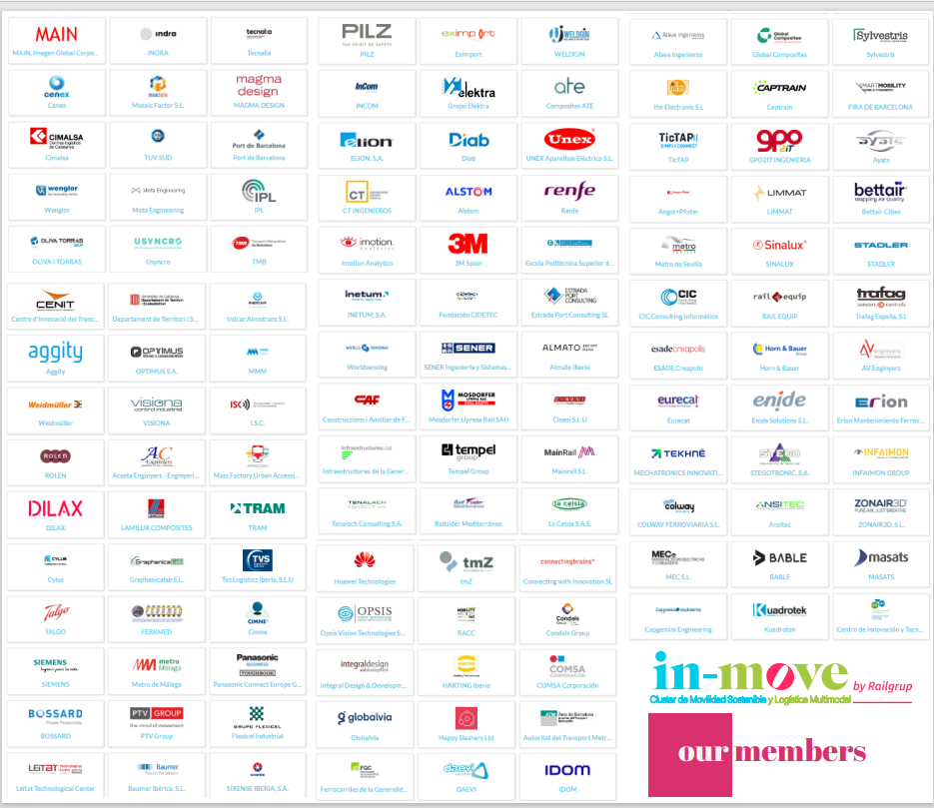
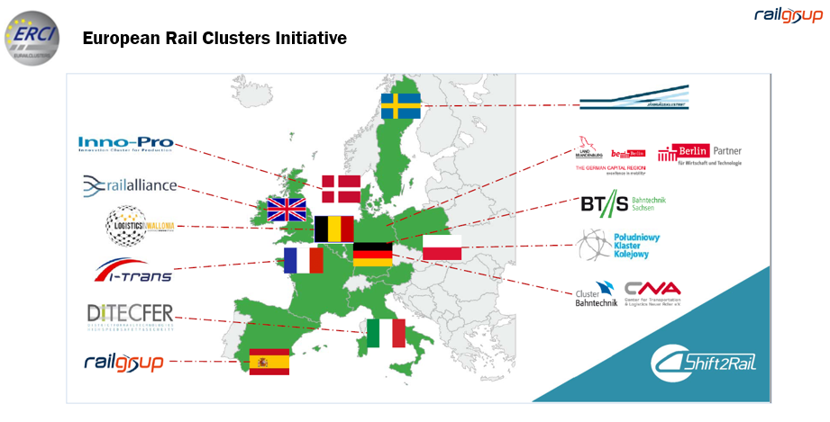
IN-MOVE partnerships, alliances and networks

Slide 5


Strategy
KNOWLEDGE
Success Cases
Target Promotions
Being a benchmark in Sustainable Mobility
LIVEABLE MOBILITY – MOBILITY CENTER
OPEN INNOVATION Cluster
Eco-Innovation
Hydrogen
CCAM
&
Low Emission Logistics
Our challenges
Ben an agent for change
Identify scenarios for enhancing competitiveness
Generate value for our members

Slide 6

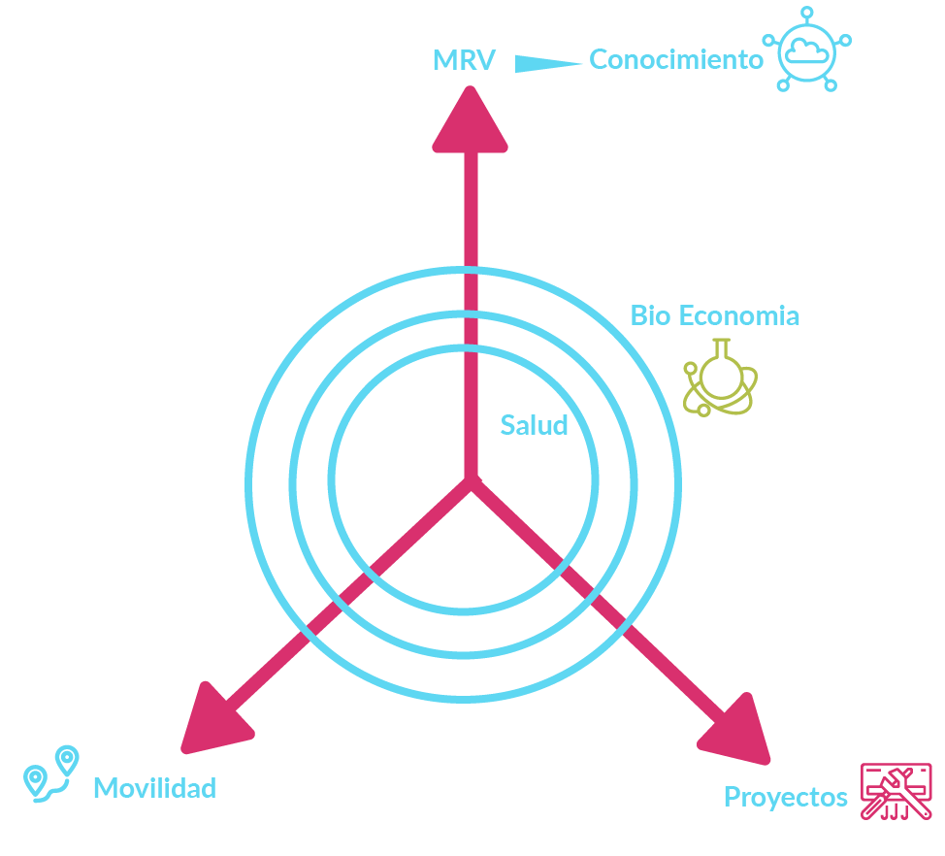
Strategy
Our challenges
Ben an agent for change
Identify scenarios for enhancing competitiveness
Generate value for our members

Slide 7





in-move Brands
Our Brand(s)
Development and differentiation for
IN-MOVE brand(s):
Branding for the cluster key activities of
More efficient and straightforward Communication
Less e-mails, more information
Mailing and Communication plan specifically designed to reach the target audience
PROJECTS - TENDERS
(lab)
Grupos de Trabajo
Success Cases

Slide 8
Modi in a nutshell
Horizon Europe framework
HORIZON.2.5 - Climate, Energy and Mobility
  HORIZON.2.5.7 - Clean, Safe and Accessible Transport and Mobility
  HORIZON.2.5.8 - Smart Mobility
  HORIZON-CL5-2022-D6-01-01 - European demonstrators for integrated shared automated mobility solutions for people and goods (CCAM Partnership)
Project information
MODI: A leap towards SAE L4 automated driving features
Coordinator: ITS Norway
Partners: 34 (27 participants + 2 affiliated entities + 5 associated partners)
Timeline: 1 October 2022 - 31 March 2026
Total cost: € 27,992,880 - EU contribution: € 23,030,095
Funding scheme: Innovation Action (IA)

Slide 9


No net emissions of greenhouse gases by 2050
Economic growth decoupled from resource use
No person and no place left behind
Technology that works for the people
A fair and competitive digital economy
An open, democratic and sustainable society
Notes:
MODI Addresses two of the biggest current political priorities
Grean deal: Climate change and environmental degradation are an existential threat to Europe and the world. To overcome these challenges, the European Green Deal will transform the EU into a modern, resource-efficient and competitive economy, ensuring:
A Europe fit for the digital age: Ensure that we in Europe fully exploit all the opportunities offered by the rapid adhesive development.
The digital transition should work for all, putting people first and opening new opportunities for business. Digital solutions are also key to fighting climate change and achieving the green transition.
The transport mobility sector as a whole is one of the major pillars
Sustainable and smart mobility strategy. How we can achieve these two goals, hereof:
Zero emissions for road transport
Automobility – deployed on a large scale across Europe by 2030

Slide 10




Automated transport is crucial to overcome freight transport challenges
Notes:
Main logistic challenges:
Liable business models/high cost level
Time efficiency
Driver shortage
Safety

Slide 11
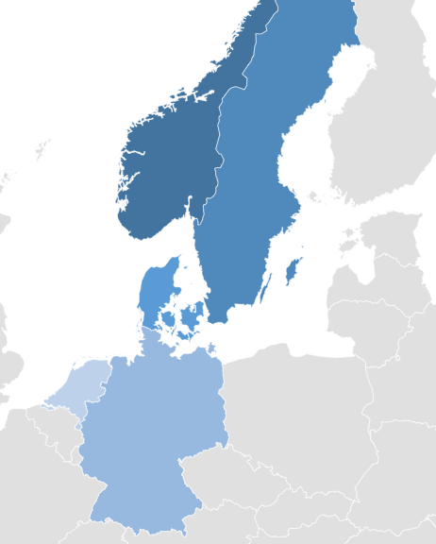

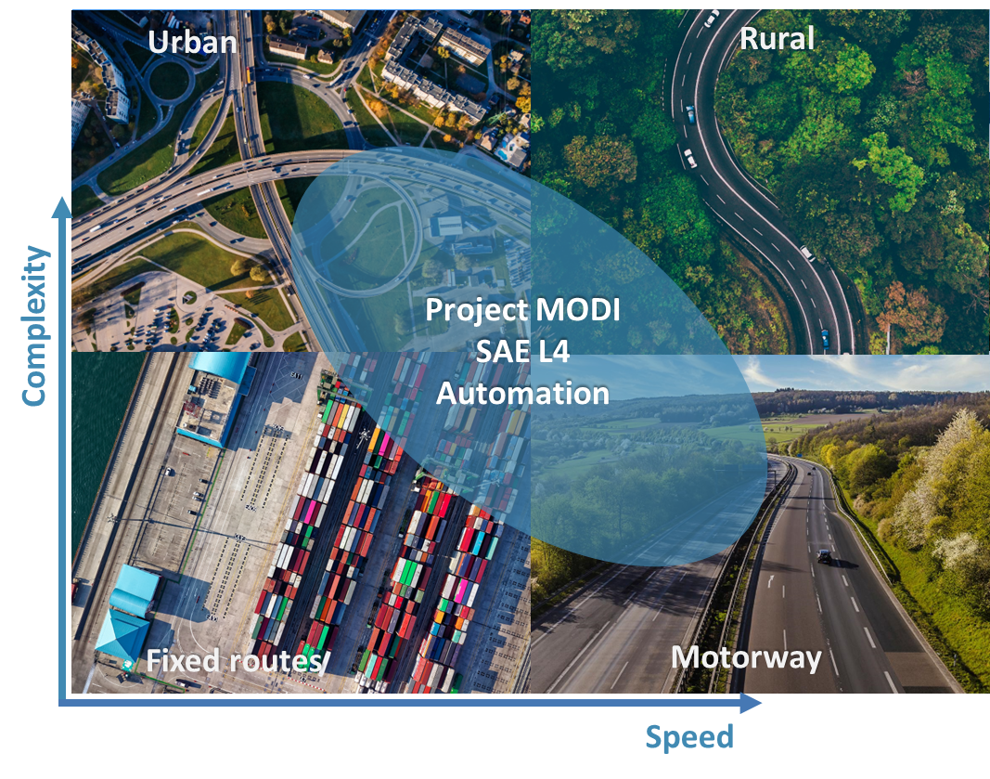








Overview
Logistic corridor from Rotterdam to Oslo
Identify and largely resolve barriers on this corridor, in confined areas and on public roads ​
Leveraging with other projects
Use case Norway
Border to port
MODI CCAM test corridor
From Rotterdam to Oslo
Use case Sweden
Hub-to-hub
Use case Germany
Motorway to harbour
Use case the Netherlands
Port operation

Slide 12
The ambition of MODI
Accelerate the introduction of CCAM solutions to significantly improve logistic chains
The MODI project aims to accelerate the adoption of highly automated freight vehicles through demonstrations and by overcoming barriers to the rollout of automated transport systems and solutions in logistics.
MODI will demonstrate automated heavy-haul vehicles use cases on the logistics corridor from Rotterdam in the Netherlands to Moss in Norway, crossing four national borders and demonstrating terminal operations at four different harbours and terminals in route.
Automated transport will significantly contribute to improving European transport and logistic chains. The MODI initiative will contribute to make substantial steps toward identifying and resolving barriers preventing this from coming true.
Notes:
More details for the Speaker as described on the GA:
The ambition of MODI is to take automated driving in Europe to the next level by demonstrating complex realife
CCAM use cases while:
• Showing the local, national and international context of freight transport with CCAM vehicles, both in
confined areas and on public roads.
• Cooperating and cocreating with logistics companies, road operators, vehicle OEM’s, providers of
physical and digital infrastructure and other stakeholders to bridge the gap between R&D and marketready
L4 solutions for long-distance operational design domains.
• Creating innovative business models and improved business models across the logistics chain.
• Proving that the technology soon can deliver on promised benefits at relatively high speeds and medium
traffic complexity, including a coordinated CCAM system to support smart traffic management.
• Paving the way to enable highly automatic transport on important corridors, connecting main ports
across Europe.
• Accelerating CCAM in Europe by setting examples of business-wise CCAM integration in logistics.

Slide 13
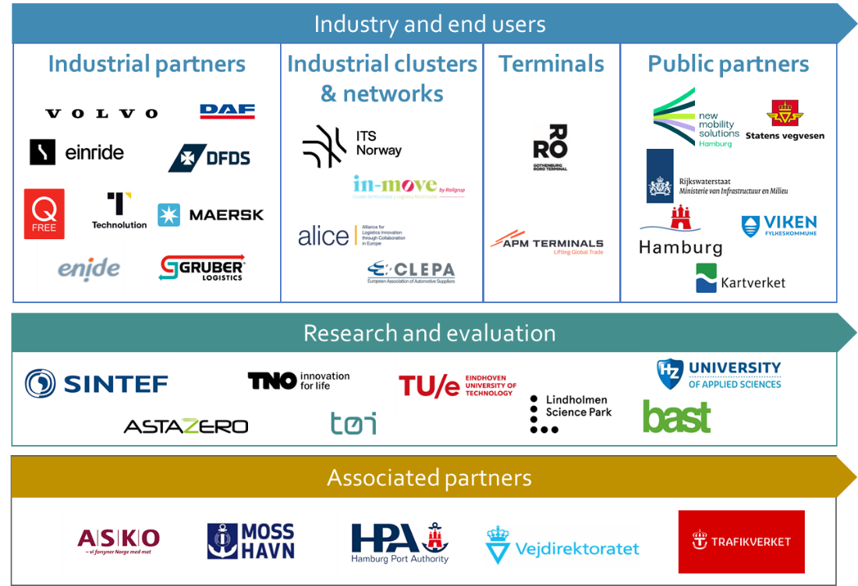
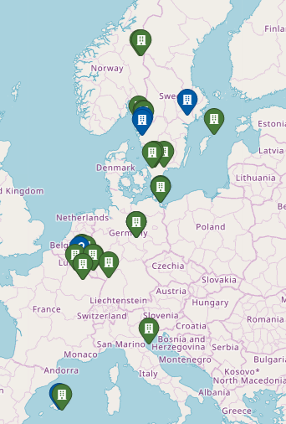
Consortium
34 organisations from 8 countries: 27 Participants, 2 Affiliated entities and 5 Associated partners
Notes:
Note for the presenter/Speaker:
The consortium comprises 29 partners (27 participants + 2 affiliated entities), of whom 16 are representing industrial organisations, vehicle providers, logistics, and associations, 8 research organisations and universities, and 5 road authorities, public bodies, and cities/regions along the corridor, representing the complete value chain.
They include:
Industrial partners
• EINRIDE AB, SE
• DAF TRUCKS NV, NL
• VOLVO TECHNOLOGY AB, SE
• ENIDE SOLUTIONS SL, ES
• Q-FREE NORWAY, NO
• TECHNOLUTION BV, NL
• DFDS AS, DK
• A.P. MOLLER – MAERSK A/S, DK
• GRUBER LOGISTICS S.p.A., IT
• GOTHENBURG RORO TERMINAL AB, SE
• APM TERMINALS MAASVLAKTE II BV, NL
Clusters & Industrial networks
• ITS NORWAY, NO
• IN-MOVE BY RAILGROUP, ES
• ALICE, BE
• CLEPA, BE
Research organizations
• ASTAZERO AB, SE
• SINTEF AS, NO
NEDERLANDSE ORGANISATIE VOOR TOEGEPAST NATUURWETENSCHAPPELIJK ONDERZOEK,
NL
• TRANSPORTØKONOMISK INSTITUTT, NO
• BUNDESANSTALT FUER STRASSENWESEN, GE
• LINDHOLMEN SCIENCE PARK AKTIEBOLAG, SE
• TECHNISCHE UNIVERSITEIT EINDHOVEN, NL
• STICHTING HZ UNIVERSITY OF APPLIED SCIENCES, NL
Public authorities
• NMS NEW MOBILITY SOLUTIONS HAMBURG GMBH, DE
• STATENS VEGVESEN, NO
• MINISTERIE VAN INFRASTRUCTUUR EN WATERSTAAT, NL
• STATENS KARTVERK, NO
• FREIE UND HANSESTADT HAMBURG, DE
• VIKEN FYLKESKOMMUNE, NO
Plus 5 additional Associated partners (no EU budget allocated for them)
• TRAFIKVERKET, SE
• VEJDIREKTORATET, DK
• PORT OF HAMBURG, GE
• MOSS HAVN, NO
• ASKO, NO

Slide 14
Objectives
O.1
  Implement the latest technology and overcome major CCAM deployment barriers for logistics by demonstrating business-oriented and well-integrated CCAM systems for use cases (UCs) along a transport corridor and between hubs.
O.2
  Define recommendations for adaptations of supporting infrastructure, vehicle regulations and standards to enable broader deployment of CCAM, speeding up the introduction of CCAM vehicles and recommendations for further (e.g., large scale) piloting.
O.3
  Demonstrate business models and partnerships for the application of CCAM vehicles in logistics.
O.4
  Perform technical & socio-economic impact assessments and communicate them in the context of the best practices of the MODI L4 CCAM solutions and systems for real-world conditions.
Notes:
Note for the speaker:
There are 4 sub-objectives in O1:
Sub-objective 1.1: Develop and implement innovative technologies on a variety of CCAM vehicles for transport of goods.
Sub-objective 1.2: Develop a standardised interface for coordinating automated vehicles as part of the digital infrastructure, which is validated in logistics operational use cases that have a high business prospect for deployment and are fulfilling the needs of logistics stakeholders.
Sub-objective 1.3: Demonstrate physical and digital infrastructure solutions towards a successful and quick CCAM deployment in private areas and the public domain.
Sub-objective 1.4: Demonstrate solutions for CCAM interoperability between countries and cross-border traffic and propose harmonization for regulations and border controls.

Slide 15

Methodology
The overall objective of MODI is to speed up the introduction of CCAM vehicles for logistics by demonstrations and overcoming barriers for the roll-out of automated transport systems and solutions in logistics
Obj 2: Define recommendations for :
Adaptations of physical and digital infrastructure
Regulations and standards to enable broader deployment of CCAM
Obj 4. Perform an impact assessment and communicate the best practices of the MODI L4 CCAM solutions and systems in real world conditions
WP1 Requirements, business models and recommendations
WP2 Use case definition and impact assessment
WP6 Exploitation, communication and dissemination
Obj 1. Implement the innovative vehicle- and
PDI-technology and overcome major CCAM barriers
Obj 3. Demonstrate business models and partnerships for the application of CCAM vehicles in logistics
WP3 Vehicle sub-system development
TRL 5 -> TRL7
WP4 Coordinated CCAM interface and optimal PDI
TRL 5 -> TRL7
WP5
Demonstrate at TRL6 and 7 in the five use cases
Roadmap to
Implementation
2025: AVs for logistics driving in confined areas, between hubs and roads outside cities
2030: AVs for logistics driving on specific public road stretches at higher speeds
2035: AVs for logistics driving on motorways in mixed traffic situations

Slide 16
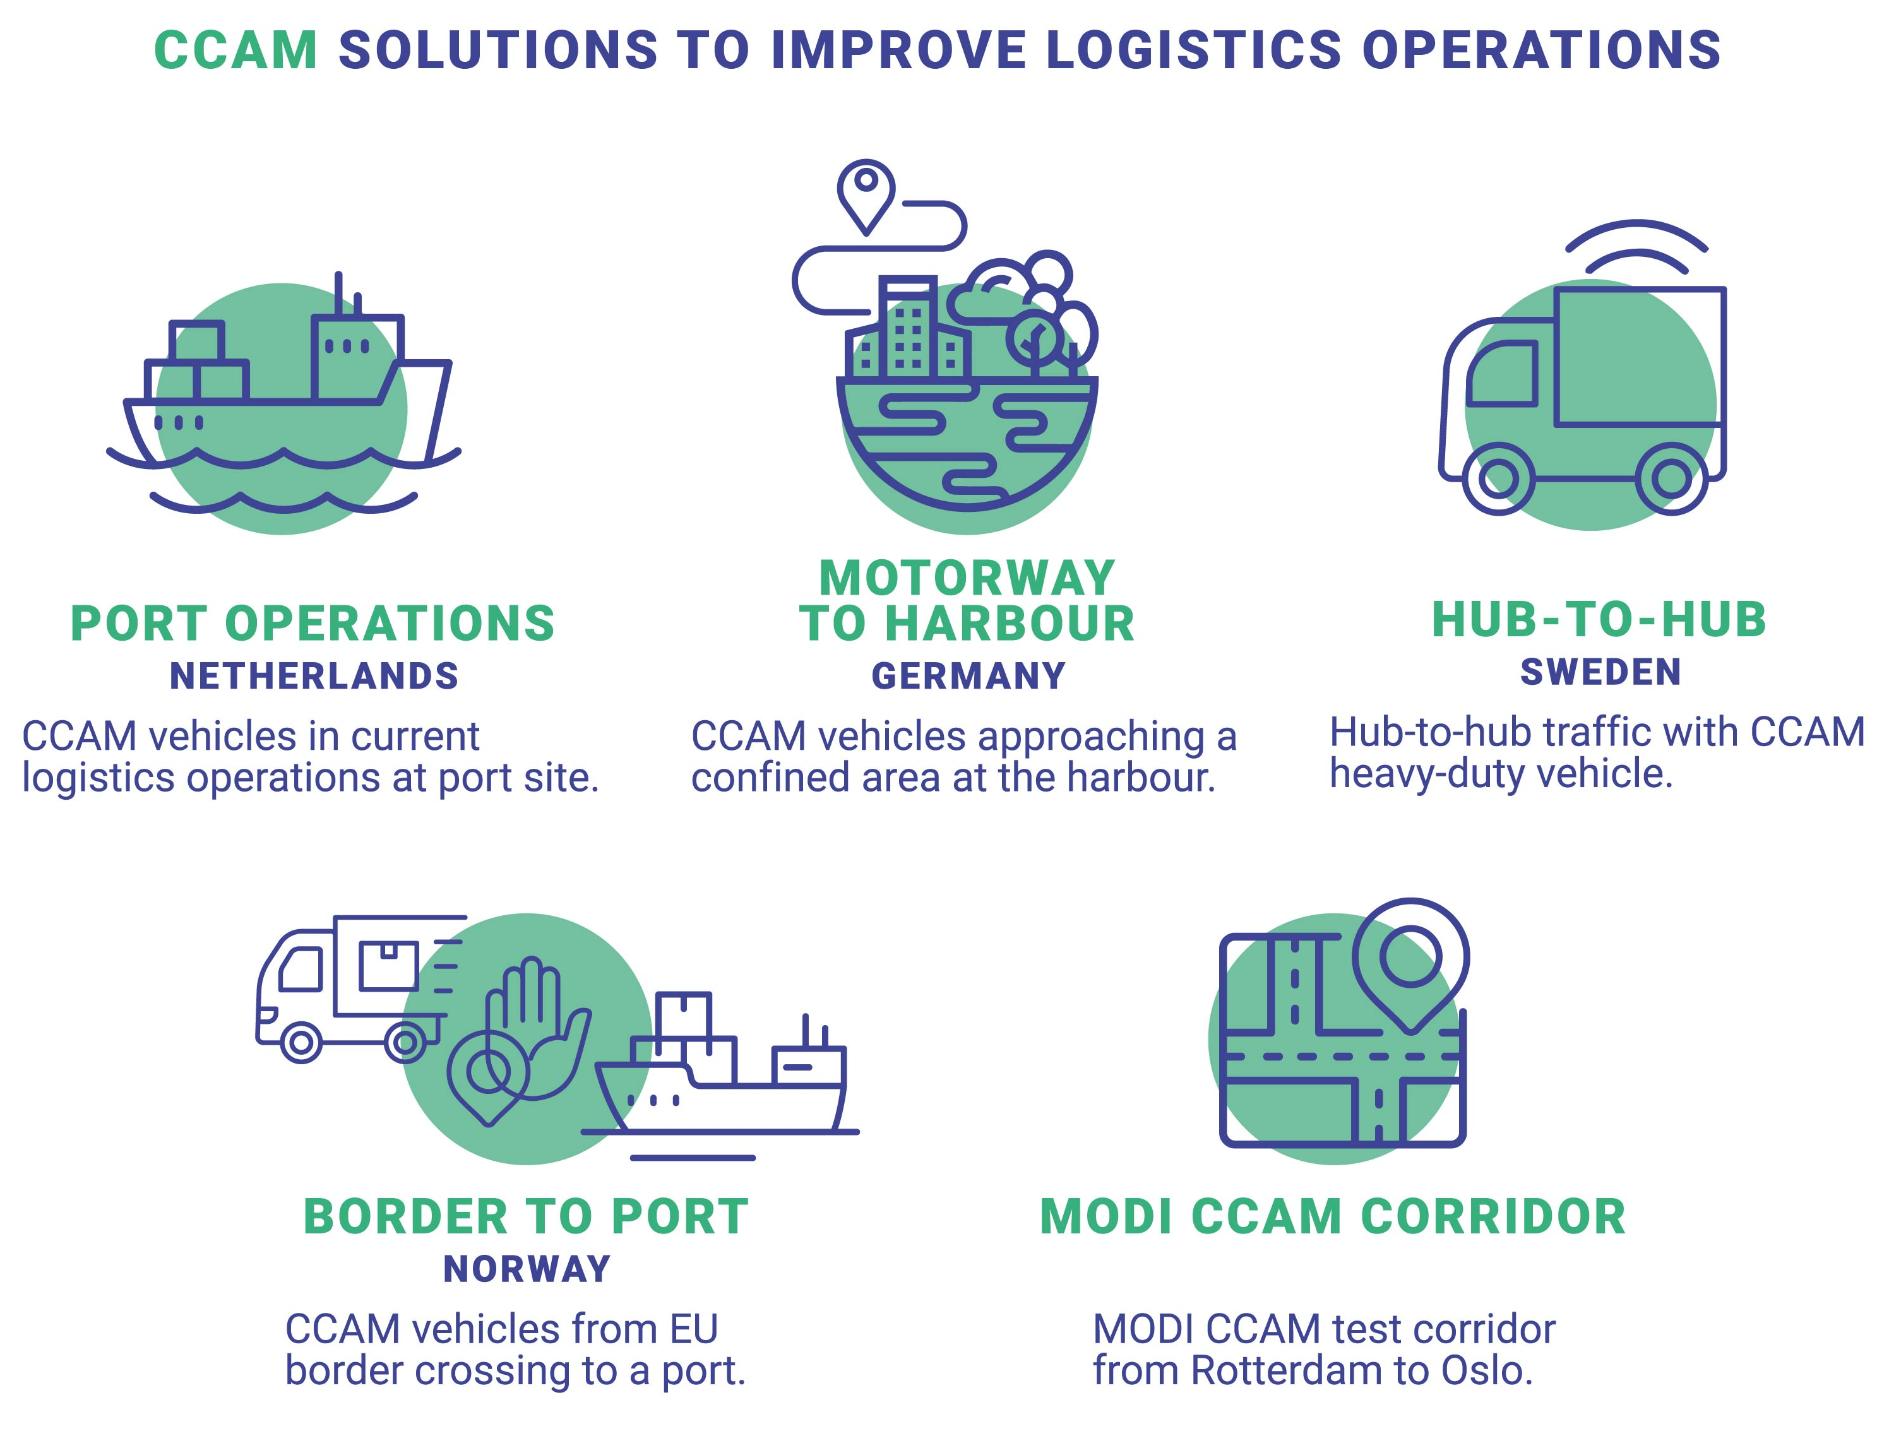
Use cases
Notes:
Note for the speaker:
[1]This slide will be updated shortly with figures in line with the other C&D materials and channels (website, brandbook, flier, etc.) under development
[2] There are cover pages for each of the 5 uses cases (go to insert, add new slide and select any of them). However, Norway use case’s picture requires permission from the photographer. Please contact modi@railgrup.net to make sure we can use this picture before developing your presentation. Thank you.
---
Text for the figure:
Introduce 5 MODI use cases:
Port Operations (title)
CCAM vehicles on port site. (text below)
+ (picture of a ship/Port)
Motorway-to-harbour (title)
Automated trucks approaching a confined area via motorway. (text below)
+ (picture of a truck in the city)
Hub-to-hub. (title)
Hub-to-hub with automated heavy-duty vehicle (text below)
+ (picture of truck)
4. Border-to-Port (title) (Do not use the picture on the cover for Norway use case until photographer grants us permission to use it freely for C&D purposes)
Automated vehicles from EU border crossing to a port (interoperability). (text below)
+ (picture of check point /border control pass)
MODI CCAM corridor (title) MODI CCAM test corridor from Rotterdam to Oslo. (text below)
+ (picture of road/highway)

Slide 17
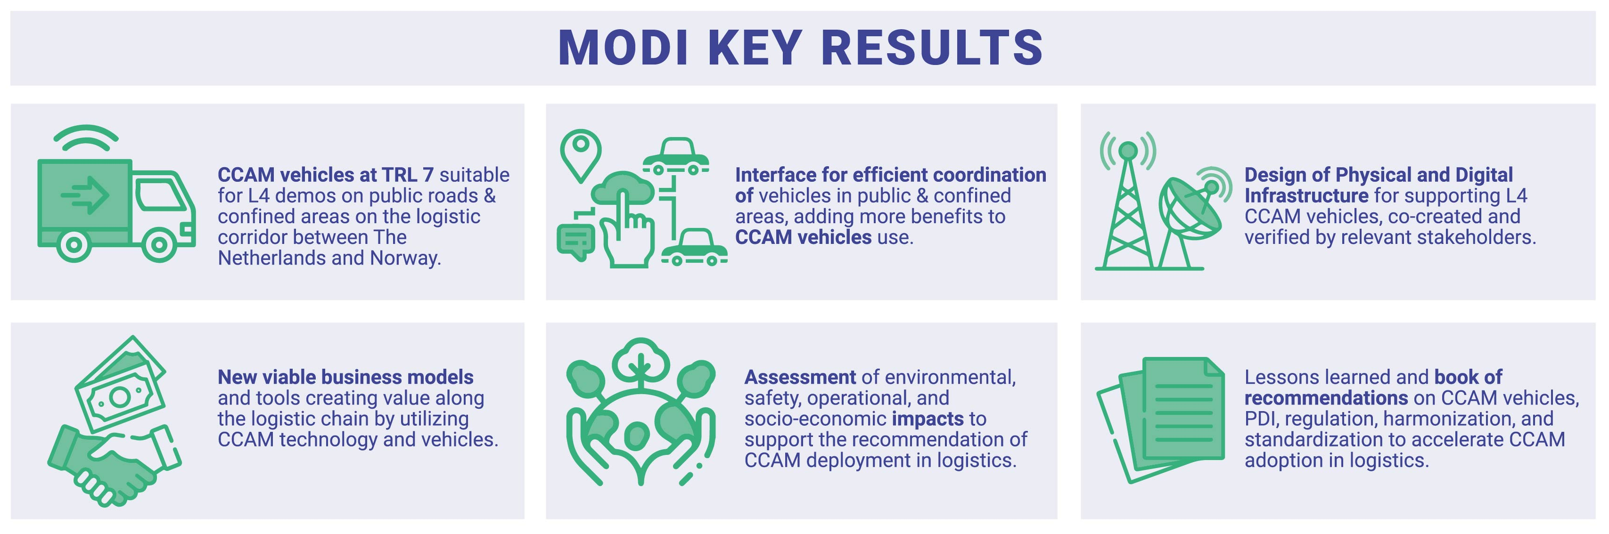
Expected outcome
Notes:
[This slide will be updated shortly with figures in line with the other C&D materials and channels (website, branbook, flier, etc.) under development]

Slide 18





Follow us and don’t ever miss out!
Website
Twitter
LinkedIn
YouTube

Slide 19
Ignasi Gómez-Belinchón
Vicent Pastor
gerencia@railgrup.net
otp@railgrup.net
www.modiproject.eu

